Slide 1

Transformers (2007)
Sean Barry, Christain Defranco, Kaitlyn Fichtner, and Ben Peters
Notes:
Sean will read the title and his name, please then say your name in order

Slide 2
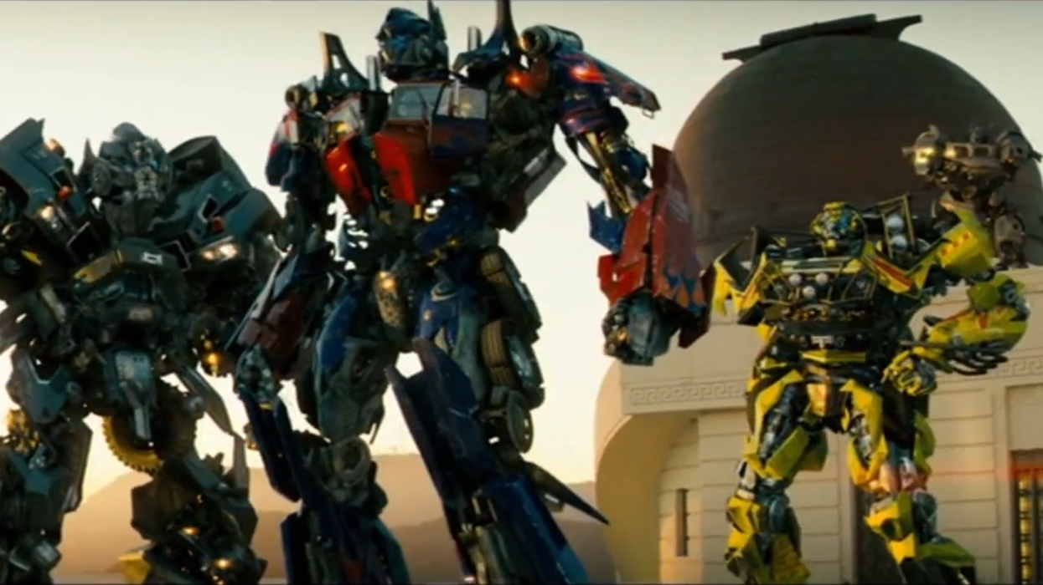
Plot Summary
Allspark is created and gives rise to Transformers
Allspark is lost to space
Allspark is found
Decepticons search for the Allspark
Autobots arrive on Earth
Virus takes the entire internet offline
U.S. army agrees to help Autobots
Autobots defeat decepticons
Notes:
The Allspark is created at the beginning of time and is used to create the Transformers. War and chaos erupt on the Transformers home planet during which time the Allspark is lost to space and ends up landing on Earth. When the Allspark is found by the first Seven, president Hoover hides it from the world by having Hoover Dam built around it. Many years later the Decepticons come to Earth in search of the Allspark. In an attempt to get more information about the Allspark they attack a Military base and hack into the U.S. government network and plant a virus. Shortly after the Decepticons arrive on Earth the Autobots also arrive on Earth. After a short conflict between the a secret government agency called Sector 7 and the Autobots Bumblebee is captured and taken to Hoover Dam. The virus that was planted in the government network has spread to the entire internet and in one swift motion takes everything offline. The government realizes that they have the same goals as the Autobots and decide to work together to keep the Decepticons from getting the cube. There is a final battle where the Autobots defeat the Decepticons and destroy the Allspark in the process.

Slide 3
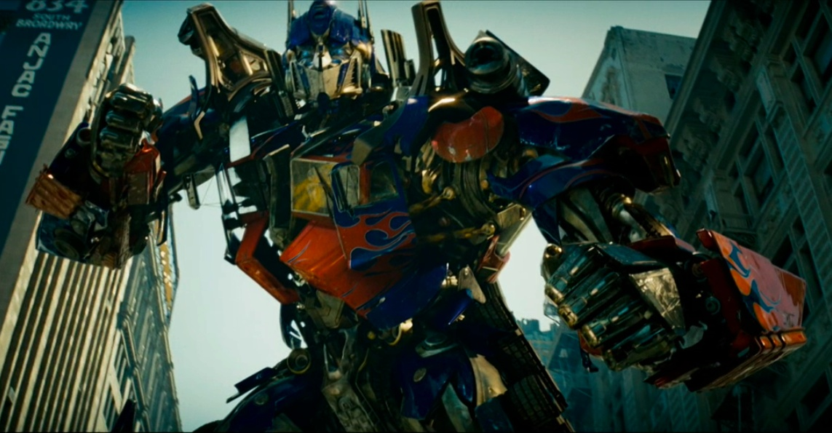
Conclusions
Humans are much more capable when they are able to effectively communicate with each other
The amount of personal information that you put on the internet can have disastrous effects on you as well as your family
The government plays a large role in keeping us safe, but they also censor important information
Networks as important as those in the government need strong security and reliability to protect against cyber attacks
Notes:
Each read off their own conclusions in order

Slide 4

List of Technologies
Old | Current (2007) | Future | Fictional
CRT Monitor | Ipod Radio Communication Video Calls Radar Internet Satellite Cellphone Computer Virus | Quantum Computing Holograms | Allspark Transformers
Notes:
In the movie there were many different kinds of technology, more than thought would be after rewatching it. The plot allowed for use of old, current and new technology which made it more engaging. Since the movie is almost 14 years old now, a lot of the current tech is outdated, like the video calls (that they were using), cell phones and computer tech in general. The future technology that was used had a pretty realistic portrayal, especially the holograms. Quantum computing was used as a virus, allowing a decepticon to hack into the us government, which does not seem too unrealistic.Surprisingly the only fictional technology other than the transformers themselves, was the allspark, which is used to give technology life.

Slide 5
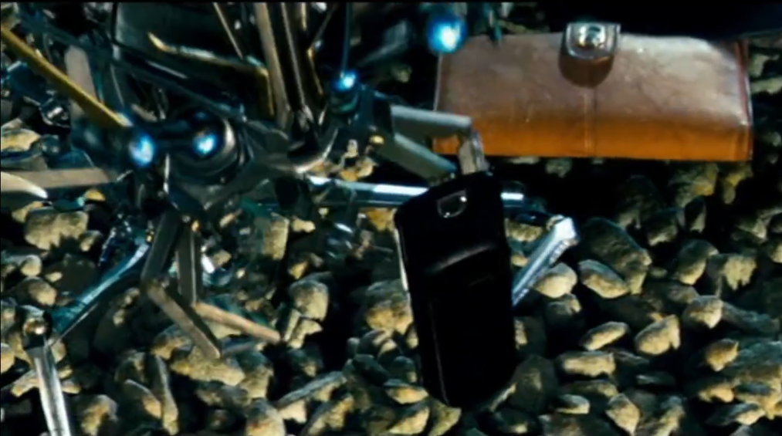
Chapter 3 - Networked Communications (Phones)
Use as a backup form of communication
After attack on Soccent base
Sector Seven ambushed
Providing access to Sector Seven
Frenzy disguises himself as Mikaela’s phone
In 2007 75% of adults in the U.S. owned cell phones [1]
Notes:
One of the most common uses of cell phones in this movie was as a backup form of communication. Because of the high availability of cell phones they make for an excellent backup to other types of communication devices. We see cell phones used in this way a few times in the movie. The first time that we see a cell phone it is being used as a backup to the radio that was fried during an attack by the Decepticons. Shortly after Captain Lennox and his team escape from the attack they start trying to find a way to get in contact with his superiors to tell them that they were still alive as well as to share the information that they learned about the Decepticons. The first thing he asks about is if anyone has a cell phone in the village that one of the characters comes from. We then see this team fight off a Decepticon only after finding a cell phone and calling the Pentagon to get support. Another example of this is when Sector Seven is ambushed by the Autobots to rescue Sam. While the agents are being lined up and handcuffed to each other one of them thinks to use their cell phone which was not taken away to call for help which shortly arrives and frees them. We can see from both of these examples that only by being able to communicate with their superiors were these two teams able to defeat their vastly superior enemy. Another key use of a cell phone is when the Decepticon Frenzy transforms into Mikaela’s phone. Once he has transformed he is taken everywhere that Sam and Mikaela go which ends up leading him directly to the Allspark where he then tells the other Decepticons where it is located. We see widespread adoption of cell phones in this movie which is accurate for the time as 75% of adults in the U.S. owned cell phones in 2007 showing that the ability to quickly and conveniently get in touch with others is a highly valued capability.

Slide 6
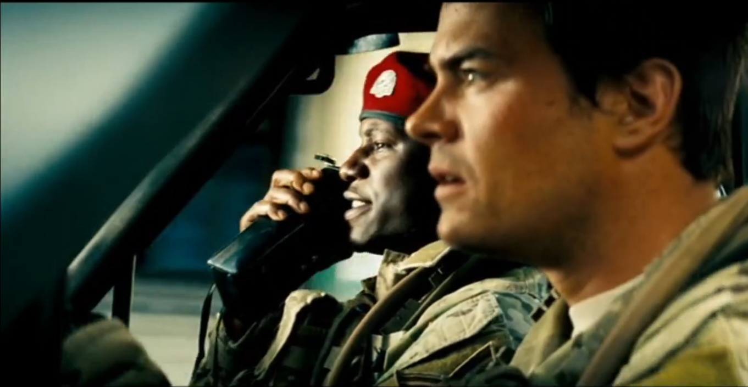
Chapter 3 - Networked Communications (Radios)
Primary form of communication between forces
Used to communicate between ground forces and air support
Provides range of up to 65 miles with only a handheld two-way radio [2]
Also served as the only lasting form of communication after the virus
Morse code over shortwave used to get support for the final battle
Constantly updating others about what is going on during the final battle to get help
Notes:
The other main way that characters communicated in the movie was via radios. Initially, we see the use of standard two-way radios to communicate between ground personnel as well as to attempt to communicate with the Decepticon who was disguised as an air force helicopter. However, we see these fail shortly after the attack leaving the survivors stranded and in need of another form of communication. One of the main reasons that two-way radios are so widely used is because they have an impressive range. Because you can get around 65 miles out of a handheld radio means that you can communicate with reinforcements that are still on their way as well as allowing you to communicate directly with aircraft that can provide support. Additionally, we see older radios put to use after the virus takes the internet down. Presumably, some portion of the long-range capabilities of the radio system used by the army was connected to the internet leading to it failing with the internet. However, the older transistor-based shortwave radios are still working and are eventually used to coordinate support for the final battle allowing the Decepticons to be defeated. Only through the constant communication that a portable and long-range connection that radios provided was the army able to defeat the Decepticons.

Slide 7
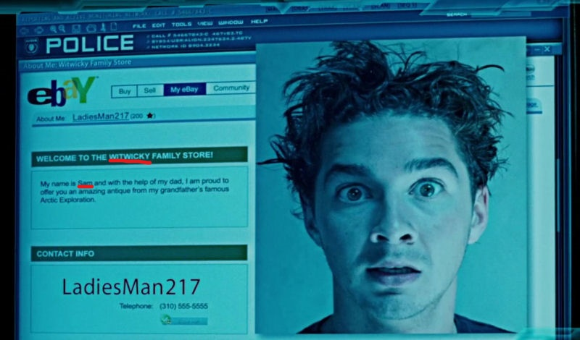
Chapter 5 - Information Privacy
Without seeing the glasses on Ebay, the Transformers never would have realized Sam’s connection to the Allspark
Ebay allows any transaction partner to request the buyer/seller’s contact information [5]
Notes:
The Decepticon named Frenzy was able to quickly find Sam’s Ebay page by making a Yahoo Search of Sam’s last name “Witwicky”. Sam did use the username “LadiesMan217” instead of using his real name. However, the welcome blurb on his Ebay page says “Welcome to the Witwicky Family Store!” and “My first name is Sam” so anyone could easily figure out that this Ebay page belonged to him. Furthermore, Ebay’s policies allow any transaction partner to request a seller’s contact information including name and address. Frenzy was able to use this information to find Sam’s location by searching the police database. Frenzy finding Sam was critical to the plot of this movie since it allowed Frenzy to disguise himself as Mikaela’s phone to be brought with Sam and Mikaela to Sector Seven. The Autobots were also easily able to use Sam’s Ebay page to figure out that Sam was Captain Witwicky’s grandson and that Sam had the glasses they were looking for. If the Decepticons and the Autobots had not seen the image of Captain Witwicky’s glasses on Sam’s Ebay, the Transformers may have never realized Sam’s connection to the Allspark and Sam and his family could have avoided all of the dangerous situations they were put in throughout the movie. Sam’s experience with the Transformers may lead him to be more conscious of what personal information he puts on his Ebay page in the future.

Slide 8
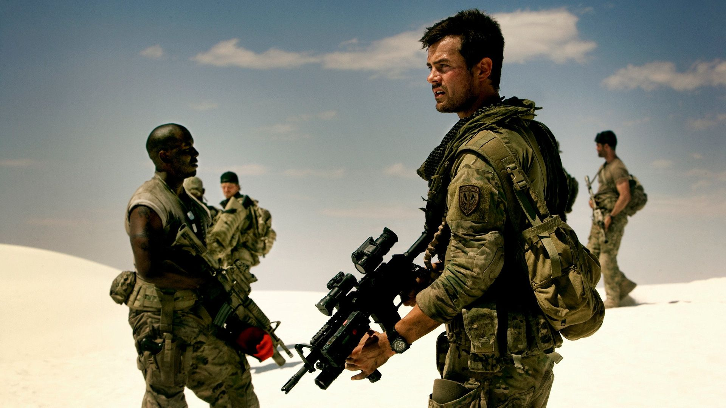
Chapter 6 - Privacy and Government
Sector 7, a secret government agency, hides all information regarding transformers from the public, and actively suppresses anyone trying to find out
The US military is the only force stopping Decepticon attacks, essentially serving as humanity’s last line of defence
Notes:
When it came to privacy and government, this movie did have a decent amount. First is sector 7, a secret government agency that has hidden transformers from the public eye for decades. They use megatron and the allspark to develop new technology for us to use. They also actively suppress anyone who attempts to find out information about either sector 7 or transformers, with multiple raids happening in the movie. The military has a prominent role in the movie, as they are our last line of defence against the decepticons. They are constantly mobilizing to meet any threats that pop up, which is a good thing because in the movie, there are many threats to be dealt with.

Slide 9
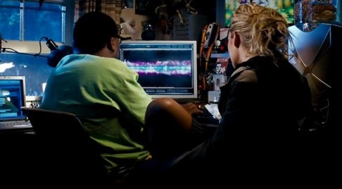
Chapter 7 - Computer and Network Security
In the Qatar scene, a physical attack on the military base led to a near breach of classified documents
A second, more covert attack on Air Force One led to another close call, although many government documents were compromised
Notes:
While the cyber attacks in the movie were completely fictional, utilizing technology that the government couldn’t combat, there were numerous examples that stressed the importance of quick action and network security. In the attack on Qatar military base scene; Blackout, A Decepticon, attempts to steal classified information about the AllSpark location but Colonel Sharp is quick to cut the hard lines. In a second, more sneaky attack on Air Force One, The Decepticons manage to steal information on Project Iceman, information leading to their later pursuit of Sam Witwicky. While in both of these examples there wasn’t much anyone could do, constant monitoring and quick action prevented the Decepticons from obtaining the cube’s location.

Slide 10
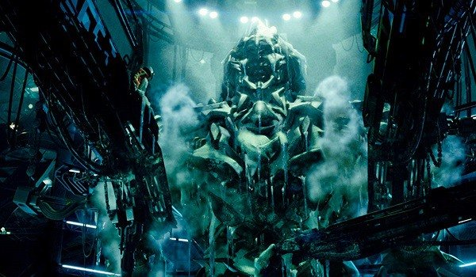
Chapter 8 - Computer Reliability
A blackout in the pentagon and led to the inability of the characters to communicate with each other. They ended up resorting to traditional radio communication
The backup generators in the Hoover Dam couldn’t supply enough power to keep Megatron frozen during the attacks
Notes:
A more preventable issue shown in the movie was that of computer reliability. In the scene where the pentagon loses power and all forms of communication, there was no backup plan. The characters are forced to use old-school radio communication to carry out the rest of their mission. Another example of a preventable issue was the hoover dam blackout. It was specifically stated in the movie that the backup generators alone could not supply enough power to keep megatron frozen and as a result, led to him escaping. When megatron was discovered in 1934, the government should have implemented better safety precautions when dealing with a system as important this one.

Slide 11
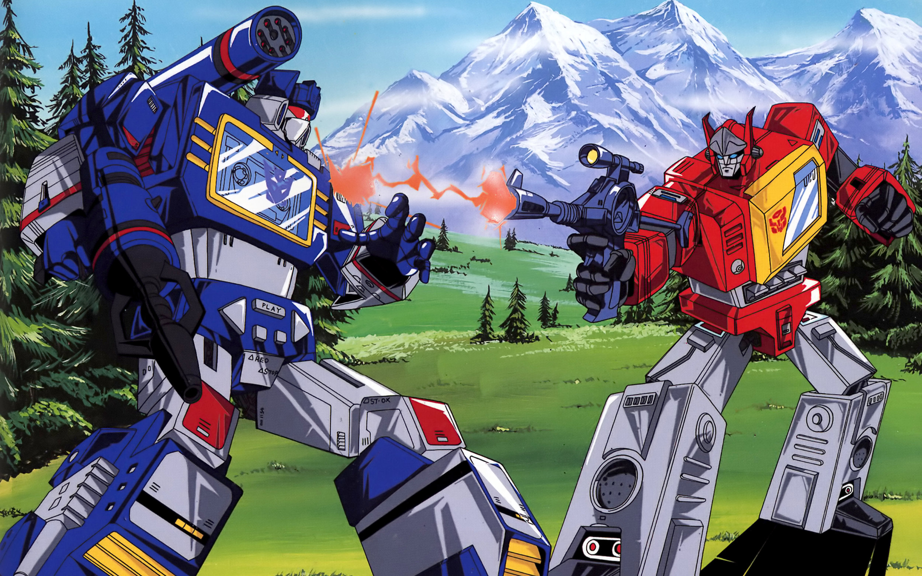
Fan Reactions
$709 million worldwide, 3rd highest grossing movie of 2007 [4]
Fans of original animated series were very unhappy
39,000 people were trying to hack Michael Bay’s computers [3]
Backlash & death threats
Notes:
The Transformer movies were a success, making $709 million worldwide and becoming the 3rd highest grossing movie of 2007. Transformers was so popular that 5 more movies were made in the franchise in the following years and they are still making more. Another Transformer movie is set to be released in the summer of 2022. Not everyone loved the Transformer movies though. Reportedly, while the movie was being made 39,000 people were trying to hack Michael Bay’s computers to see the movie script and the appearance of the new Transformers. Many images got leaked and fans of the original Transformers animated series, which was created in 1984, were outraged by the design of the new Transformers. Bay was going for a more complex look while fans wanted the Transformers to be simple like they were in the cartoons. As a result, Michael Bay recieved a lot of backlash and even death threats. Ultimately, Bay stuck to his own idea of what Transformers should look like on the big screen because he believed that simply blowing up the cartoon characters would be “the equivalent of ‘Ghostbusters’ with the Marshmallow man”. He saw the Transformers as a way of “reinventing super heroes”.

Slide 12
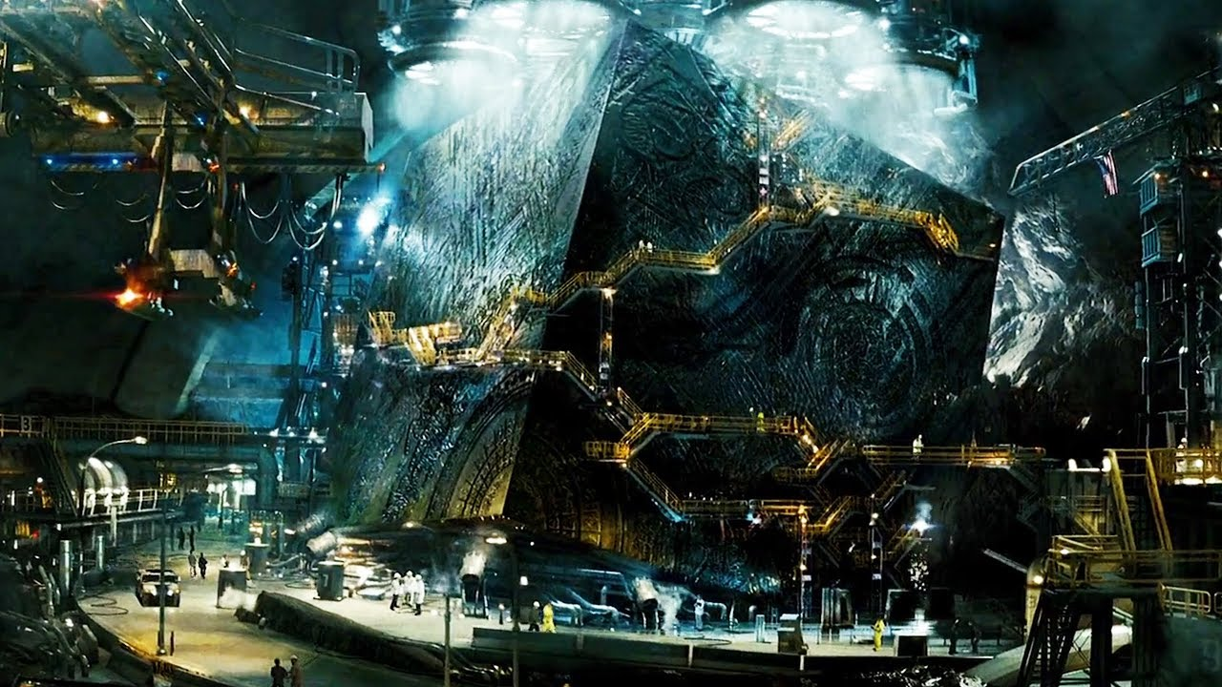
References
Mobile Fact Sheet, (Pew Research Center, 12 June 2019), https://www.pewresearch.org/internet/fact-sheet/mobile/ (2 December 2020)
Going the Distance With 5 Watt Walkie Talkie Radios, (Midland, 2020) https://midlandusa.com/5-watt-walkie-talkie-radios/ (2 December 2020)
Michael Bay interview [Video file]. (2007, December 4). Retrieved December 2, 2020, from https://www.youtube.com/watch?v=23EyDJUqV_8&ab_channel=TheMovieShowOnline
Transformers. (n.d.). Retrieved December 2, 2020, from https://www.boxofficemojo.com/release/rl3010954753/?ref_=bo_yld_table_3
Abel, J. (2015). Sellers beware: EBay will give your identifying information to anyone who bids on your auctions. Retrieved December 2, 2020, from https://www.consumeraffairs.com/news/sellers-beware-ebay-will-give-your-identifying-information-to-anyone-who-bids-on-your-auctions-072215.html
Barens, S., 2018. 6 Growing Threats To Network Security -- GCN. [online] GCN. Available at: <https://gcn.com/articles/2018/10/18/network-security-threats.aspx> [Accessed 1 December 2020].
Ecpi.edu. 2020. Importance Of Network Security: Safety In The Digital World. [online] Available
at:<https://www.ecpi.edu/blog/importance-of-network-security-safety-in-the-digital-world> [Accessed 1 December 2020].

